Slide 1
How To Leverage The GHUCCTS Recruitment Center Resources For Your Clinical Trials
Notes:
Shaunagh

Slide 2
Summary
Recruitment Core Overview
Services Offered
How to access our services
Upcoming
Research Match
Questions
Notes:
Shaunagh

Slide 3
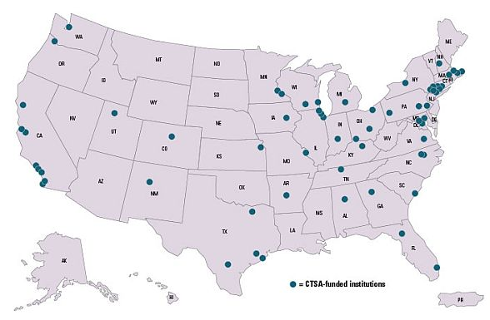
Clinical and Translational Science Awards
Notes:
62 medical research institutions – funded by National Center for Advancing Translational Sciences (NCATS)
creates a definable academic home for clinical and translational research.
CTSA institutions work to transform the local, regional, and national environment to increase the efficiency and speed of clinical and translational research across the country.

Slide 4
GHUCCTS
The primary goal of GHUCCTS is to speed improvements in human health by fostering innovative, multidisciplinary, and cross-institutional research, and by supporting the careers of those undertaking such research.

Slide 5
Research Participant Recruitment Unit
Established 2016
One of many GHUCCTS modules
Collaborative effort:
GU, HU, MHRI, DCVAMC leadership
National Recruitment Innovation Center
RPRU is for the benefit of ALL investigators at the collaborating institutions
Notes:
Shaunagh

Slide 6
Recruitment Core Services As of April 2017
Recruitment Round Tables
Recruitment Plan Development
Participant Advisory Board
Assistance with
Recruitment Specific Budget Development
Community Outreach
Digital Advertisement (including Social Media)
Research Match
Cohort Discovery
Notes:
Shaunagh

Slide 7
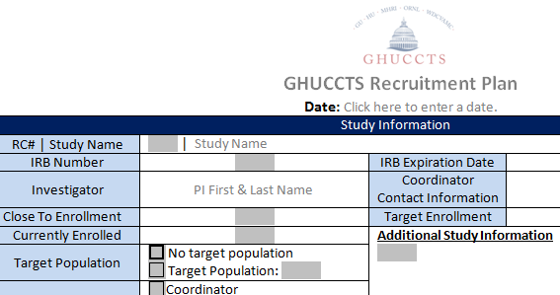
Recruitment Round Table
Round table discussions with a multidisciplinary team to assist with developing a Recruitment Plan
Bioinformaticists
Experienced investigators
Clinical Research Nurses
Coordinators
Ad Hoc Participants
Notes:
Shaunagh

Slide 8
Updates from Phase 1
Pre/Post Award Process Mapping
Notes:
Dawn
This is our outward facing process map & what we share w/ research teams when they request our services.

Slide 9
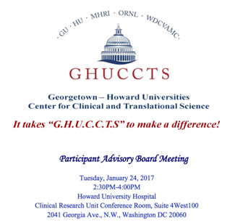
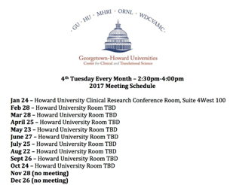
Participant Advisory Board
Notes:
Shaunagh

Slide 10
Participant Advisory Board
Mission: To represent and promote the research participant's perspective in the planning, implementation, evaluation and dissemination of clinical research activities of the Georgetown-Howard Universities Center for Clinical and Translational Science.
Vision: Enhancing safety, quality, and equity in the research process through representation and promotion of the research participant's voice.
Notes:
Shaunagh

Slide 11
Participant Advisory Board Recruitment Studios
Study teams present current or planned study to PAB
PAB members provide feedback to study team
General thoughts about the project
Study Procedures
Financial Incentives
Current Recruitment Efforts (if applicable)
Cultural Awareness in the Recruitment Plan
Print Media Strategies
Community Engagement
Study team is provided a written summary of discussion and ideas
Notes:
Shaunagh

Slide 12
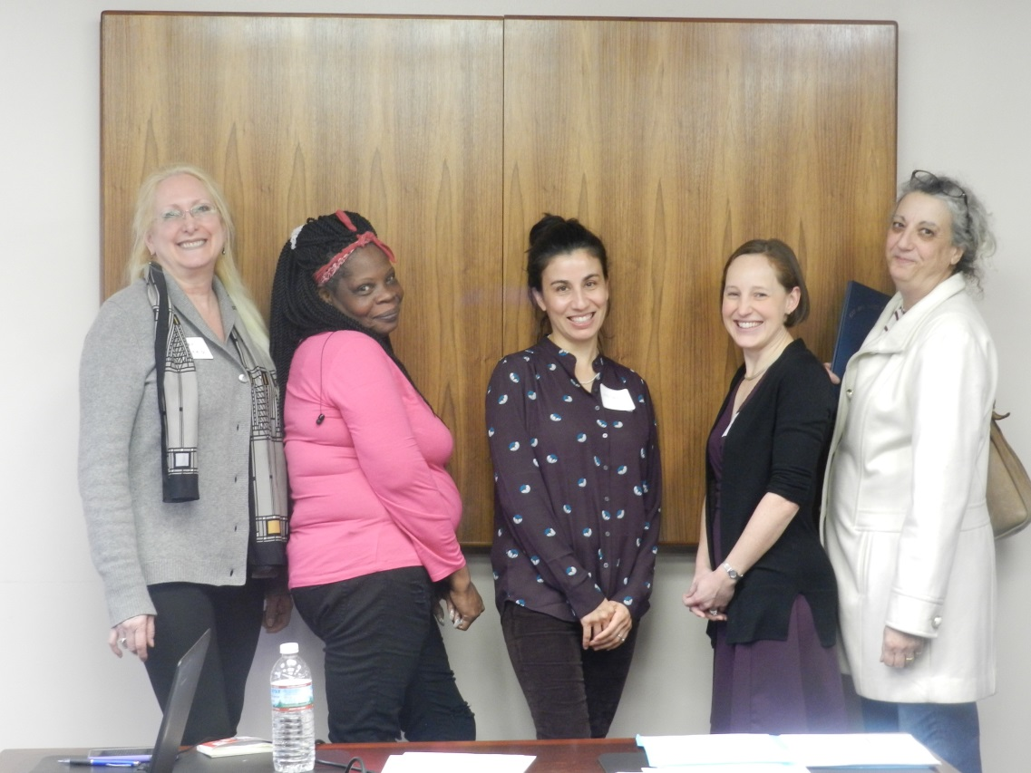
Participant Advisory Board
Notes:
Shaunagh

Slide 13
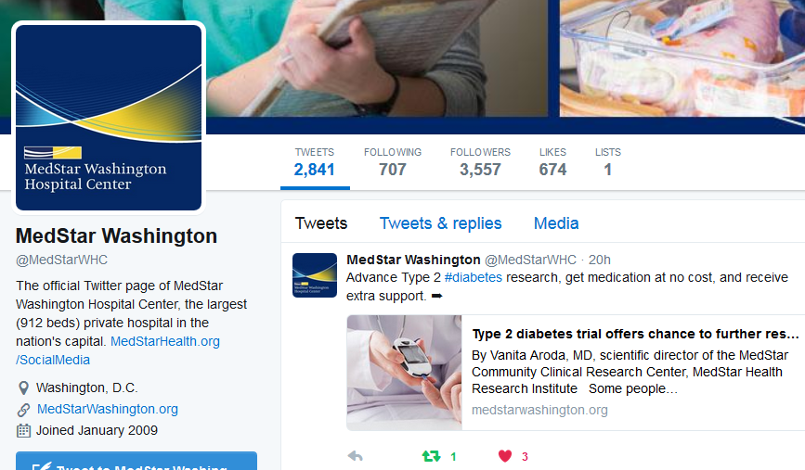
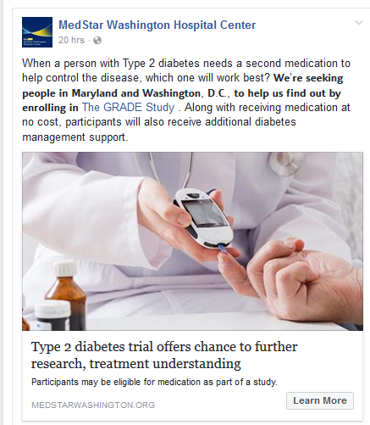
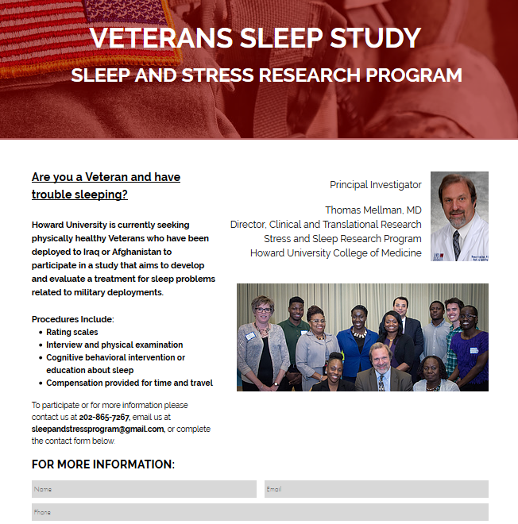
Digital Advertisement
Assistance w/ Social Media Ads
Study Landing Page
www.WePartner4Research.org/Veterans
Notes:
Shaunagh

Slide 14
Recruitment Core Services
Other Services include:
Recruitment Specific Budget Development
Community Outreach
Research Awareness
Foster a Partnership with communities and Investigators
Grow Research Match volunteer base
Cohort Discovery assistance
Recruitment best practice and resources
Notes:
Shaunagh

Slide 15
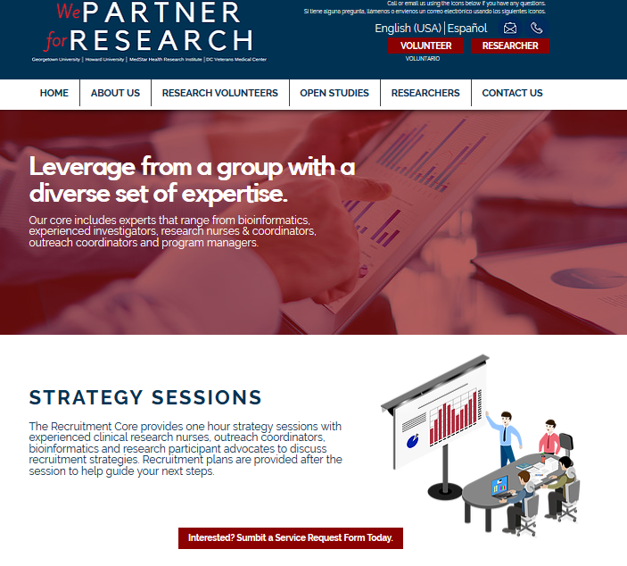
Accessing Our Services
www.WePartner4Research.org/services
Notes:
Shaunagh

Slide 16
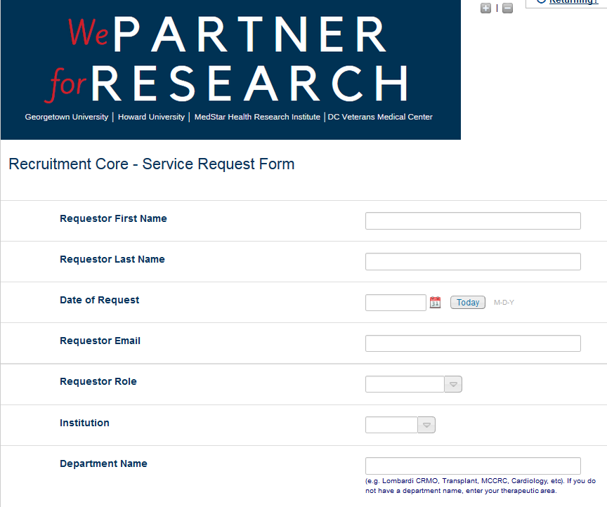
Accessing Our Services RedCap Form
http://j.mp/2nYPwT5
Notes:
Shaunagh

Slide 17
Study Tuned for More…
Trial Finder
https://rmtrialstest.app.vumc.org/search/results?condition=diabetes&gender=&age=15&healthy=&__theme=wp4r
My Chart
Research Awareness Days

Slide 18
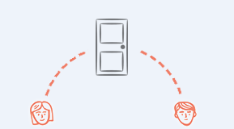
ResearchMatch
Volunteer
ResearchMatch Researcher

Slide 19
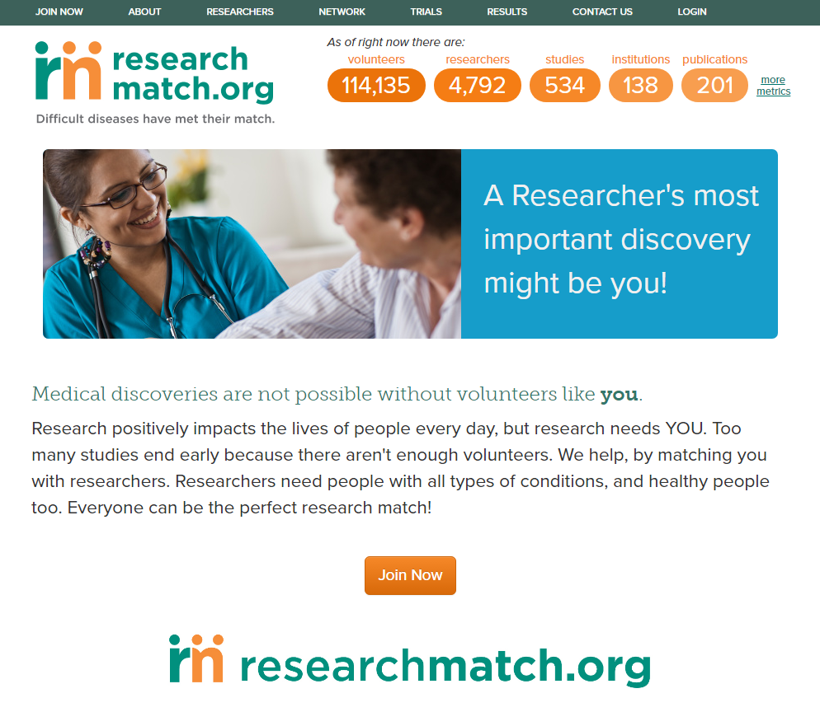
* stats as of 4/26/17
FREE
COMPLEMENTARY
CTSA-FUNDED
INNOVATIVE
COLLABORATIVE
SECURE
DISEASE NEUTRAL
‘MATCHING’
RECRUITMENT
TOOL
Notes:
ResearchMatch is an effective and trusted recruitment tool for study enrollment across a diverse field of studies and helps reduce the time and effort of researchers searching for volunteers.
RM invites volunteers to learn about and take part research studies and, my role as a liaison is to help facilitate research access, to get researchers connected to volunteers quickly and appropriately!

Slide 20
How ResearchMatch Works
Researcher registers for RM
Researcher uploads IRB approved study
Liaison reviews study and approves it for ResearchMatch use at their site
Researcher uses ResearchMatch to search for volunteers for the approved study
Volunteers receives an email from RM with study information
Volunteer accepts or denies request to learn more about the study
If yes, the volunteer’s contact information is released to the researcher

Slide 21
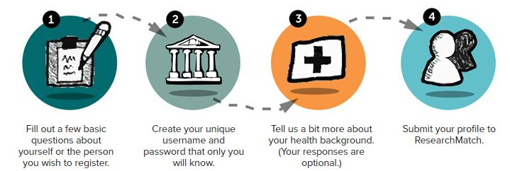
Volunteers
Notes:
Anyone residing in the United States who may be willing to learn about research studies that might be of interest to them are welcome to join!
5-10 minute registration process
Self
Parent/Guardian/Caretaker
Questions include:
Basic contact information (protected)
Secure username/password
Basic information (age, race, gender, height, weight, etc.)
Voluntary entry of health/medical conditions and medications
Preference page (e.g. how far are you willing to travel)

Slide 22
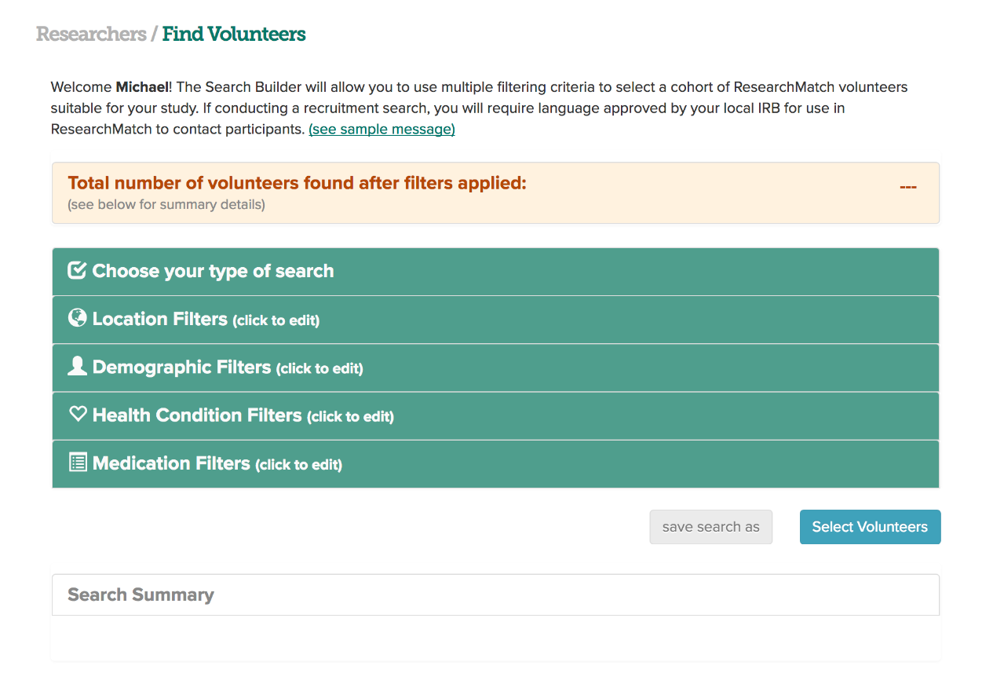
Note: When performing a feasibility search, data is rounded to the nearest 10. If you yield a count of 10, this means that 1-10 RM volunteers match your search criteria. If there are no matches, search will yield a count of 0.
Notes:
On the researcher end – you

Slide 23
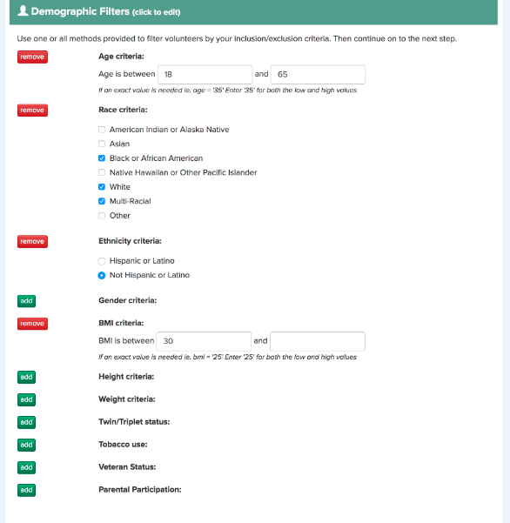
111,000
20,000
7,000
800
58

Slide 24
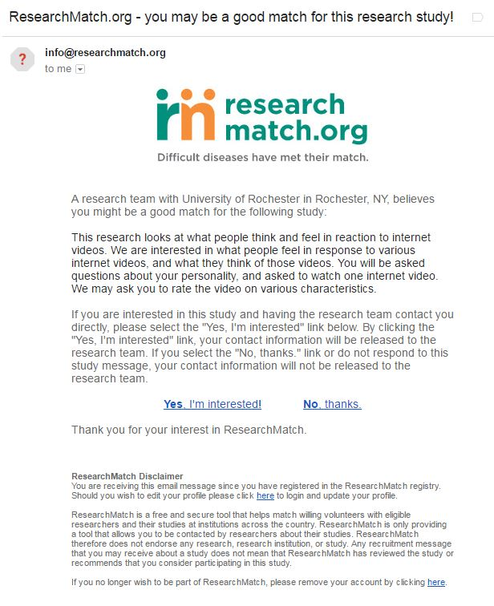
Contact Messages
Contact message researchers send through ResearchMatch must exclude:
any direct study contact information (email & phone, URL links) and must not exceed 2000 characters.
This content must also be approved by your institutional IRB.

Slide 25
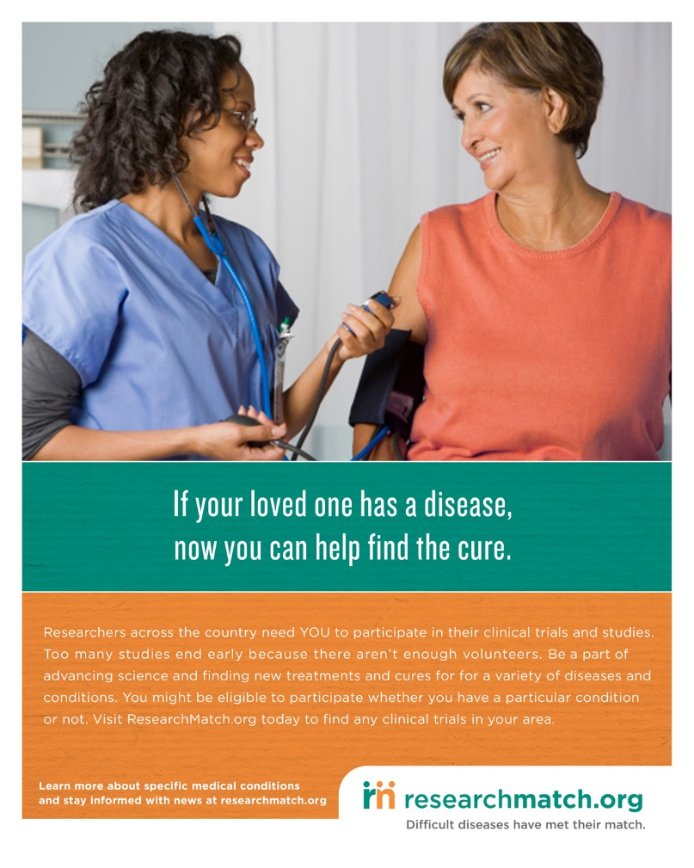
Help us,
help you!
With marketing efforts!!!

Slide 26
Questions? ghucctsrecruitment@georgetown.edu contact@wepartner4research.org www.WePartner4Research.org
Notes:
Shaunagh

