Slide 1
Working with OSR on Industry-Sponsored Clinical Trial Agreements
Doreen Robinson, Ph.D.
Sr. Associate VP for Sponsored Research
Director, Office of Sponsored Research (OSR)
27 September 2012

Slide 2
Industry-sponsored Clinical Trials: Assumptions
The sponsor will fully fund the cost of FDA Phase I, II, III or IV clinical trials
Industry-initiated trials: sponsor will provide a proprietary drug/device and study protocol to GUMC to conduct the trial
Investigator-initiated trials: sponsor will provide a proprietary drug/device for use with a GUMC investigator protocol to conduct the trial

Slide 3
Pre-Award Process for GUMC Industry Sponsored CTA
Research Team
CRU App etc.
CRU
Patient Care Costs
Protocol etc.
CDA Request
Department Chair
CTO
IRB
TCO
Cost Analysis
PACTS
Review
CTA, Protocol etc.
Budget Prep
Negotiation
Approval
IP Review
OSR
Budget
Contract Review
Sponsor
Negotiation
Patient
Enrollment
Executed Contract

Slide 4
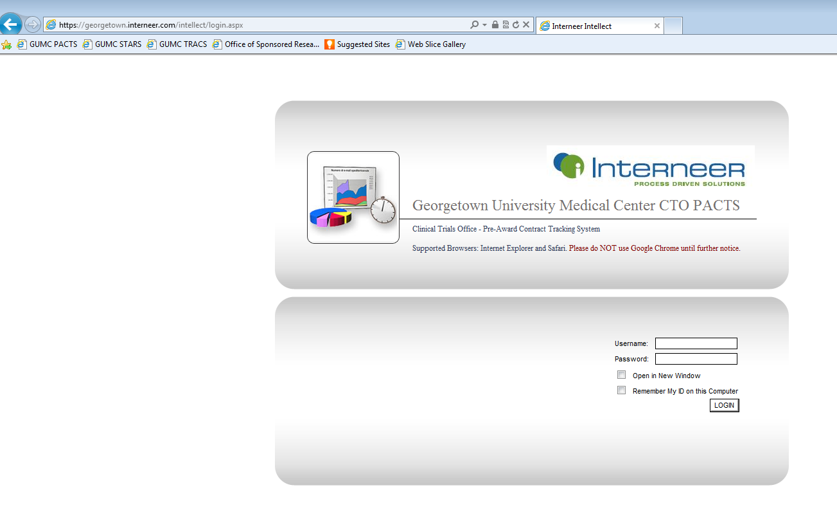
Pre-award Clinicals Tracking System (PACTS)

Slide 5
OSR Contact Information
Name | Title | Responsibility | Phone | Email
Doreen Robinson | SAVP for Sponsored Research | Strategic management, outreach, coordination | 202-687-1390 | dar82@ georgetown.edu
Trudy Bright | OSR Interim Director | CTA review, operations & management | 202-687-1227 | brightt@georgetown.edu
Manuel Corday | Assistant Director | PACTS Administration, Lung Biology, Nursing & Health Studies | 202-687-1372 | cordaym@georgetown.edu
Marjan Modini | Sr Grants & Contracts Officer | Lombardi Comprehensive Cancer Center | 202-687-7866 | mobinim@georgetown.edu
Noel Dillard | Sr Grants & Contracts Officer | Neurology, Surgery (plastic and transplant) | 202-687-4218 | nmd@georgetown.edu
Bonnie Regini | Sr Grants & Contracts Officer | Anesthesia, Biochemistry, Child Dev, Family Medicine, IRH, Medicine, Rheumatology, Surgery (general and cardiac), VA | 202-687-1306 | bmw@georgetown.edu

Slide 6
Working with OTC, OSR and CTO to Negotiate CTAs
First step: Work with OTC to obtain a Confidentiality Disclosure Agreement (CDA)
OTC is the only GU representative authorized to sign
Many sponsors require a fully executed CDA prior to sending the study protocol
Submit Request in PACTS, attachments:
Sponsor Contact Information (POC, email, phone etc.)
Clinical Trial Agreement (CTA)
Study Protocol
Important questions to answer:
Is study PI-initiated or sponsor-initiated?
Phase of trial?
Has protocol, consent form been submitted for IRB review?
Has CTO initiated budget negotiations with the sponsor?
Is the CTSA involved? If so, has CTSA been contacted?

Slide 7
CTAs: Typical Clauses
Preamble
Period of performance
Termination
Confidentiality of sponsor information
Patient confidentiality
Publication of study results
Intellectual property
Publicity & use of the university name
Indemnification (must include Medstar & MGMC)
Subject injury
Choice of Law

Slide 8
Tips for Faster CTA Negotiation
Contact OTC early to negotiate a CDA
Especially if sponsor requires it before sharing the study protocol
Engage responsible GUMC offices to work various elements of the agreement in parallel
OTC: CDA execution
IRB: Protocol approval
CTO: budget approval
OSR:
Contract review and negotiation with sponsor
OSR is the only GUMC representative authorized to sign
Coordination with other university offices
Risk management
Notification from IRB of protocol approval
OTC: intellectual property (IP) negotiation may be required
CTO: Budget language may require negotiation

Slide 9
Finalizing a CTA (and opening enrollment)
Budget (CTO) and agreement negotiations must be finalized before an agreement can be executed by OSR
OSR establishes and maintains an RX account
Notice of IRB approval is required to set up an RX account
Basis of the RX account is the internal budget approved by CTO
Any agreement modifications must be executed by OSR
Departmental Responsibilities
Coordinate with OSR to issue Personal Service Agreements (if required) for GUH personnel
Submit revised PTFs to HR to redistribute salary $$ for study personnel

Slide 10
Why is CTA Execution Taking So Long?
Reviews, Approvals, Coordination
OSR
OTC
CTO
Interface with Department
Negotiate CDA with Sponsor
Work Budget with Dept
Interface with Sponsor
Negotiate Budget with Sponsor
Negotiate IP Terms with Sponsor
Interface with GUMC Offices
Interface with OSR & Other GUMC Offices
Interface with OSR & Other GUMC Offices
Negotiate & Finalize Terms & Conditions
Department
Sponsor-Related
Working Agreement Elements Serially vs. in Parallel
Inflexible Terms & Conditions
Lack of Communication with Responsible GUMC Offices
Slow Response to GUMC Requests
Insufficient Understanding of GUMC Requirements
Other?

Slide 11
After CTA Initiation
Notify OSR of:
Change of Principle Investigator (PI)
No cost extension request
Change in number of subjects or visits
Budget must be modified
Change in study protocol
IRB re-review is required
A modified budget is required
Study cancellation or suspension
Study termination base on a serious adverse event
Study completion
RX account closeout

